Slide 1
雲端計算
Cloud Computing
Platform as a Service

Slide 2
Agenda
Introduction
  From IaaS to PaaS
  What is PaaS
  PaaS properties and characteristics
Cloud Platform
  Case studies

Slide 3
Introduction
From IaaS to PaaS
What is PaaS
PaaS properties and characteristics

Slide 4
What Has IaaS Done
IaaS provides virtual machines and resources such that IaaS vendors can segment resources for each user
IaaS providers can also make users do not need to purchase the hardware
IaaS can make better use of resources
But is it enough?

Slide 5
What IaaS Can Do
Traditional IT
IaaS

Slide 6
IaaS is Not Enough
IaaS provides many virtual or physical machines, but it cannot alter the quantity automatically
Consumers might
  Require automatic make-decisions of dispatching jobs to available resources
  Need a running environment or a development and testing platform to design their applications or services

Slide 7

More Requirements
Consumers require more and more…
  Large-scale resource abstraction and management
  Requirement of large-scale resources on demand
  Running and hosting environment
  Automatic and autonomous mechanism
  Distribution and management of jobs
  Access control and authentication
  …

Slide 8

More and More…
We need more
services

Slide 9
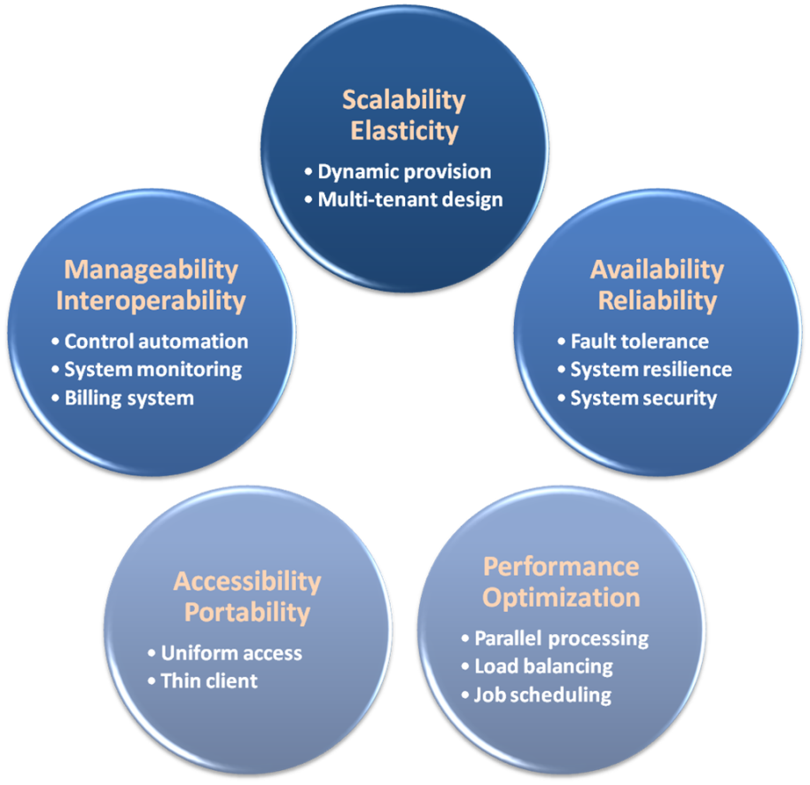

PaaS Buys It for You
PaaS provides a series of properties that can satisfy user’s requirements
PaaS guarantees the quality of resources, services and applications

Slide 10
From IaaS to PaaS
Traditional IT
IaaS
PaaS
Applications
Applications
Applications
You Manage
Data
Data
Data
Runtime
You Manage
Runtime
Runtime
Middleware
Middleware
Middleware
You Manage
OS
OS
OS
Virtualization
Virtualization
Virtualization
Provider Manage
Servers
Servers
Provider Manage
Servers
Storage
Storage
Storage
Networking
Networking
Networking

Slide 11
Introduction
From IaaS to PaaS
What is PaaS
PaaS properties and characteristics

Slide 12
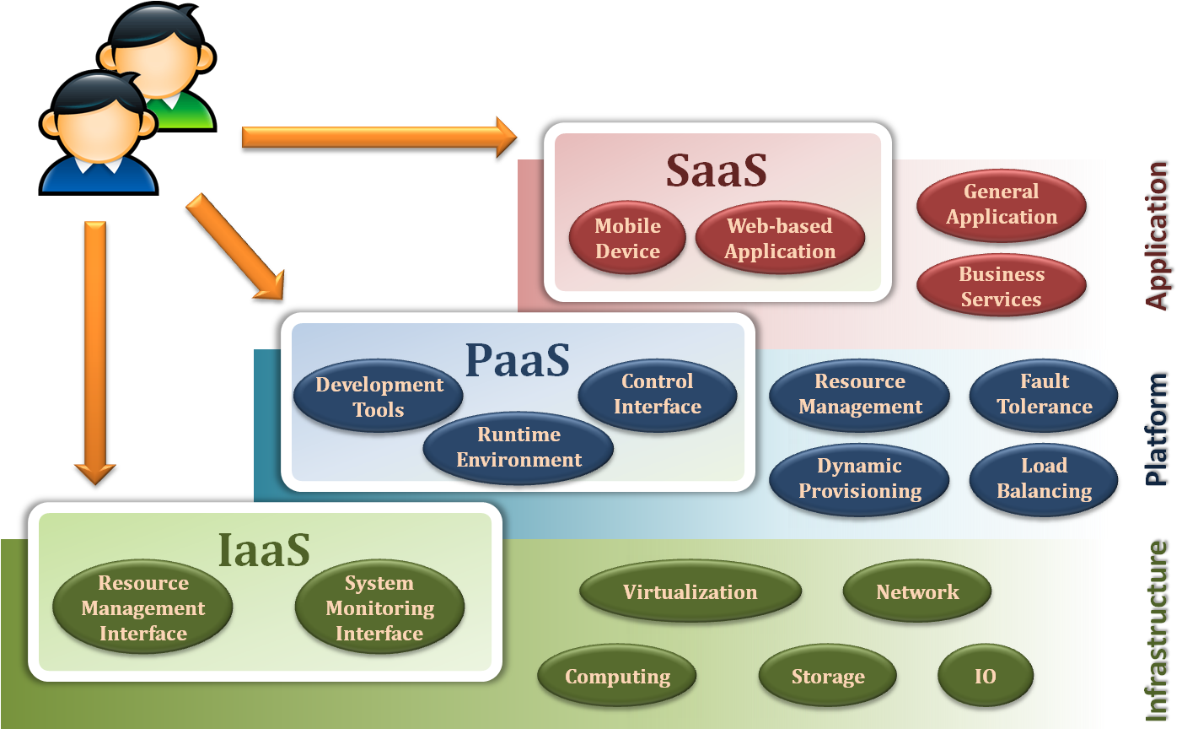
Platform as a Service
Platform as a Service (PaaS) is a computing platform that abstracts the infrastructure, OS, and middleware to drive developer productivity

Slide 13
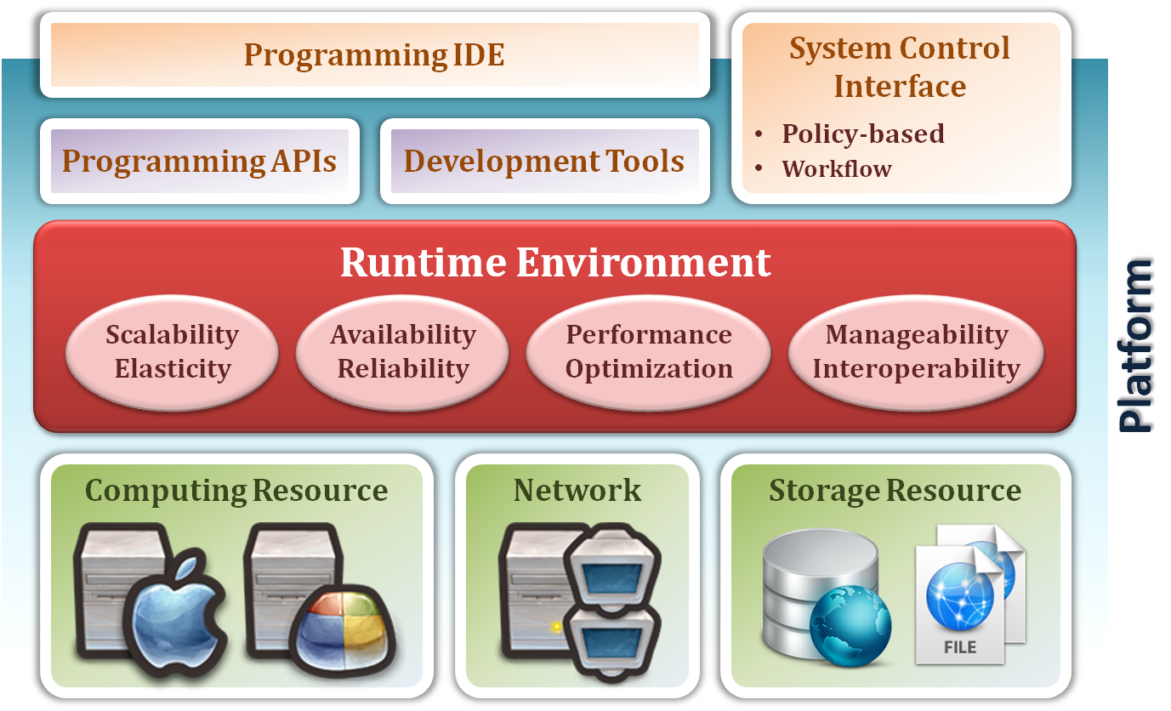
Platform as a Service
Deliver the computing platform as a service
  Developing applications using programming languages and tools supported by the PaaS provider
  Deploying consumer-created applications onto the cloud infrastructure
Enabling Services
provide
Core Platform
abstract
Resource Pool

Slide 14
Resource Pool
The capacities to abstract and control all the underlying resources
Resource Pool dynamically provides an abstraction and consolidation of large-scale resources
Consumers can acquire and return resources from the resource pool on demand
Enabling Services
provide
Core Platform
abstract
Resource Pool

Slide 15
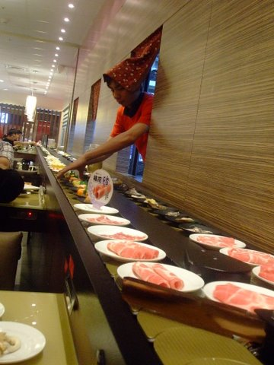
Resource Pool
Reduce the complexity and responsibility of cloud infrastructure
Provide the automatic management to provision resources
Access resources from the resource pool on demand

Slide 16


Resource Pool
PaaS providers define the smallest unit of resource
  1GHz CPU computation ability
  1GB storage space
  1MB memory capacity
  …etc
PaaS consumers can require units on their demand
Consumers may not be aware of whether provided resource is dedicate or shared

Slide 17
Core Platform
To provide a reliable environment for running applications and services
Core Platform provides basic functionalities of a PaaS environment
Act as a bridge between consumer and hardware
Enabling Services
provide
Core Platform
abstract
Resource Pool

Slide 18

Core Platform
Reduce the responsibility of the runtime environment
Based on the core platform to develop their applications
Do not need to care about how to built, configure, manage and maintain the backend environment

Slide 19
Core Platform
PaaS providers can provide a runtime environment for the developer platform
Runtime environment is automatic control such that consumers can focus on their services
  Dynamic provisioning
    On-demand resource provisioning
  Load balancing
    Distribute workload evenly among resources
  Fault tolerance
    Continuously operating in the presence of failures
  System monitoring
    Monitor the system status and measure the usage of resources

Slide 20
Enabling Services
To provide platform interfaces and services to drive the development productivities
Enabling Services provide programming IDE and system control interfaces to access the PaaS environment
Consumers can develop their applications through the APIs and development tools
Enabling Services
provide
Core Platform
abstract
Resource Pool

Slide 21
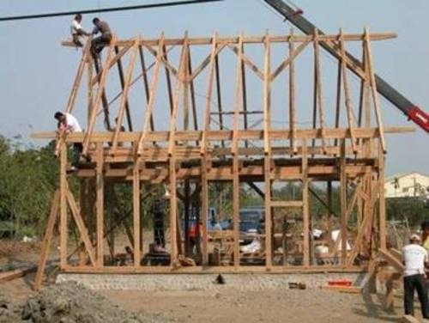
Enabling Services
Provide a development and testing platform for running developed applications on the runtime environment
Reduce the responsibility of managing the development environment
Decrease the development period
painful

Slide 22
Enabling Services
Enabling Services are the main focus of consumers
Consumers can make use of these sustaining services to develop their applications
  Programming IDE
    Integrate the full functionalities supported from the runtime environment
    Provide some development tools, such as profiler, debugger and testing environment
  System Control Interfaces
    Make the decision according to some principles and requirements
    Describe the flow of installation and configuration of resources

Slide 23
Introduction
From IaaS to PaaS
What is PaaS
PaaS properties and characteristics

Slide 24

Platform as a Service
Guarantee some properties and characteristics
  Scalability
  Availability
  Manageability
  Performance
  Accessibility

Slide 25
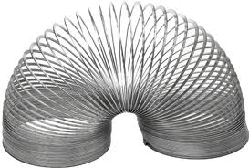
Scalability
PaaS needs to support dynamic provisioning that can increase or decrease resources on demand
PaaS provides the abstraction of cloud infrastructure and the automatic management

Slide 26
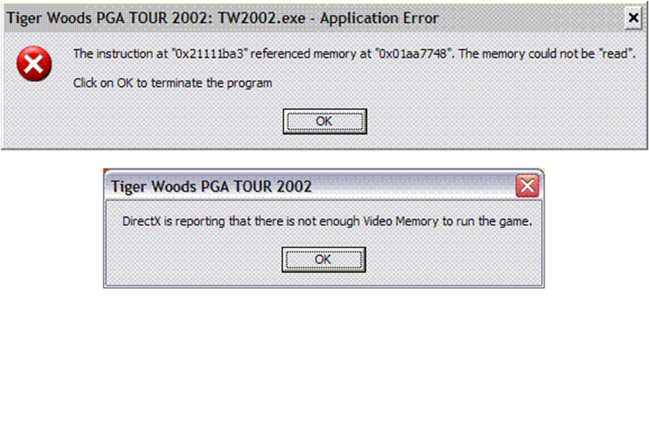
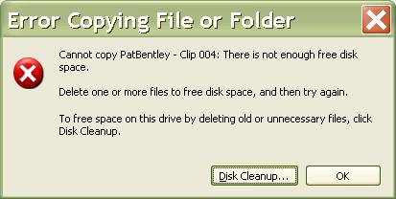
Scalability
For enterprises, they need a dynamically changed storage size or computation ability on demand
  Application may need a high peak of computation usage on morning but slow down at afternoon
  It also needs a large storage space for some time
For end users, they could not see the alert about the lack of memory or storage space
  For example…

Slide 27

Availability
PaaS needs to support the fault tolerance ability
such that system would not crash on failure
PaaS also needs to provide system resilience by duplicating applications
or services

Slide 28
Availability
PaaS supports automatic backup and disaster recovery such that consumers do not need to worry about system failures
When some resources are failed, PaaS would start up the backup resources
When applications occur fault, PaaS would migrate services to the duplicate one
There is no error

Slide 29

Manageability
PaaS needs to support self-management for running applications and services on the cloud platform
PaaS needs to provide automatic control, analysis and measurement for the resource usage

Slide 30
Manageability
PaaS provides automatic mechanisms to control the utilization of platform resources
Monitoring service provides the ability of management, analysis and operation for resources and jobs
Based on the system monitoring, PaaS can record and report the usage of resources
Consumers can pay for what they use

Slide 31

Billing
Consumers pay the bill according to how many units of resources and services they use
  Input/output network bandwidth
  Management report or warning
  CPU time
  Storage space
  Data migration
  …etc

Slide 32
Billing
Consumers can set the boundary they would not like to pay the overestimate
PaaS vendor may provide the free quota for users
PaaS vendor can also alert consumer the suddenly increased usage
As a result, consumers only pay what they use on demand

Slide 33
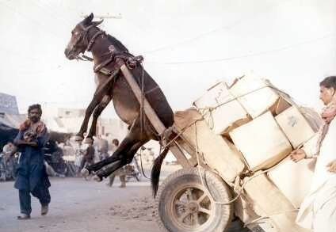
Performance
PaaS needs to support the capabilities
  Distribute jobs to idle resources
  Remove jobs from the overloading resources
PaaS also needs to distributes data to storage system with load balancing

Slide 34
Performance
Enterprise runs complicated applications on PaaS which can allocate jobs to available servers
If possible, PaaS would run application in parallel
No resource is always overloading on the load balancing PaaS
Utilization and performance could be further improved

Slide 35

Security
Security is an important characteristic in PaaS
PaaS needs to provide authentication and authorization to differentiate the access rights of different users

Slide 36
Security
Authorization can be used to control the user’s access right and reject the malicious request
Authentication is the act of establishing or confirming something or someone as authentic
All of these can limit the malicious behavior

Slide 37
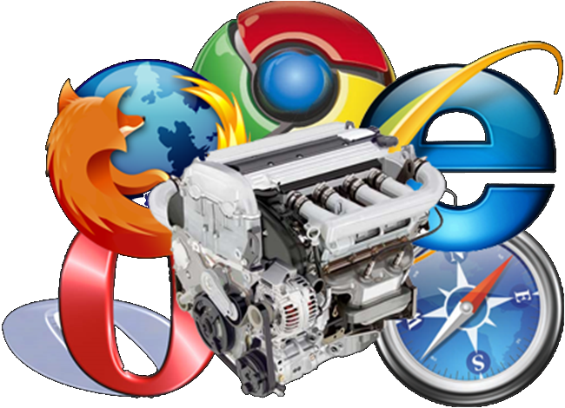
Accessibility
PaaS needs to provide an interactive interface for consumers to access cloud services or monitor the system status
Consumers could develop and test their applications via web browsers or other thin-clients

Slide 38
Summary
PaaS is a magic box
  Request anything on demand, and return the rent of resources dynamically
  Automatically build an initial environment and support self-management with high quality of service and performance
  Provide an ability of fault tolerance and disaster recovery that make services be more available and reliable
  Support the security property to limit malicious behavior in cloud environments
More important
  Do not care about how it works
  Pay as you go

Slide 39
Cloud platform
Case Studies

Slide 40

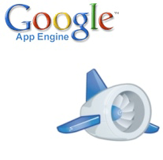

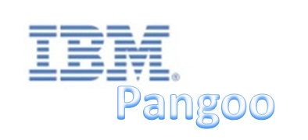


PaaS Players
PaaS venders
  Microsoft Windows Azure
  Hadoop
  Google App Engine

Slide 41

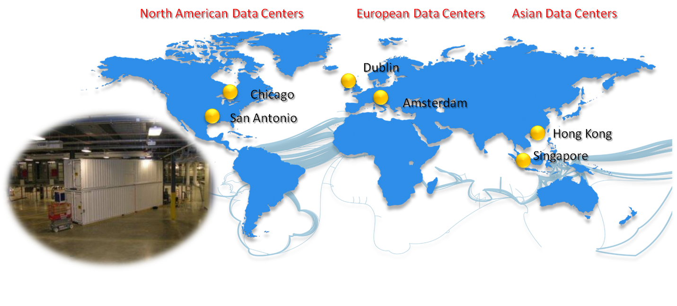
Microsoft Windows Azure
Windows Azure platform is one of PaaS vendors
  Based on .NET and Microsoft’s supported development tools
Windows Azure starts general availability at Feb 2010, and builds the global data center around the world

Slide 42
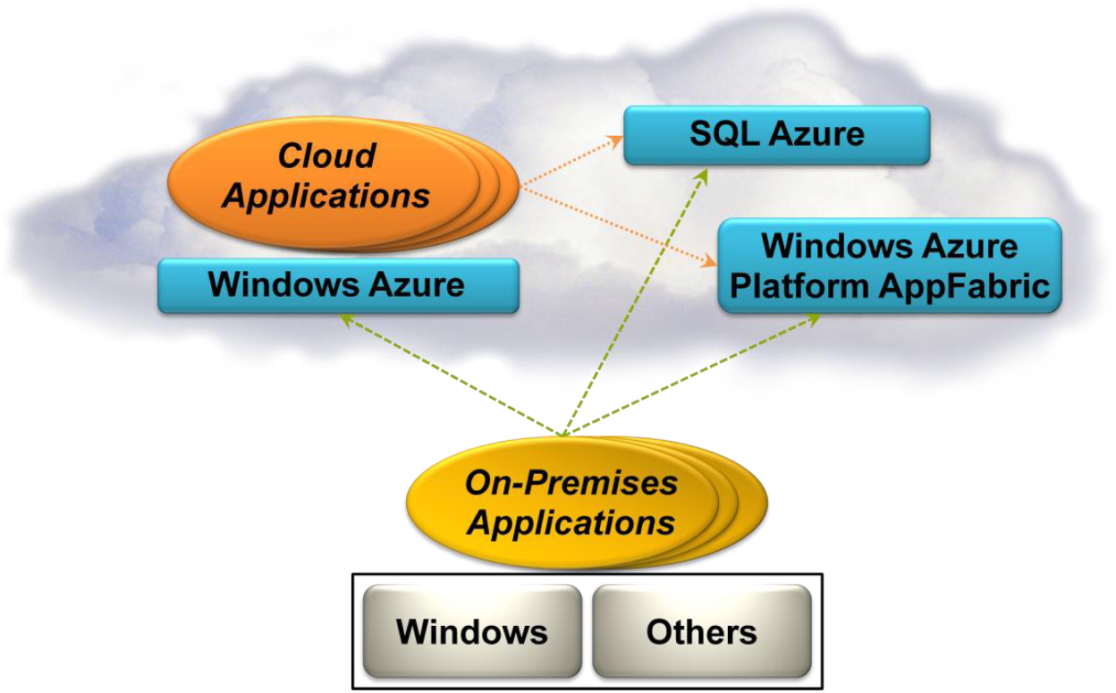
Windows Azure Platform
A group of cloud technologies, each providing a specific set of services to application developers

Slide 43
Major Components
Windows Azure
  Provides a Windows-based environment for running applications and storing data on servers in Microsoft data centers
SQL Azure
  Provides data services in the cloud based on SQL Server
AppFabric
  Provides cloud services for connecting applications running in the cloud or on premises

Slide 44
Windows Azure Platform
Windows Azure
SQL Azure
AppFabric

Slide 45
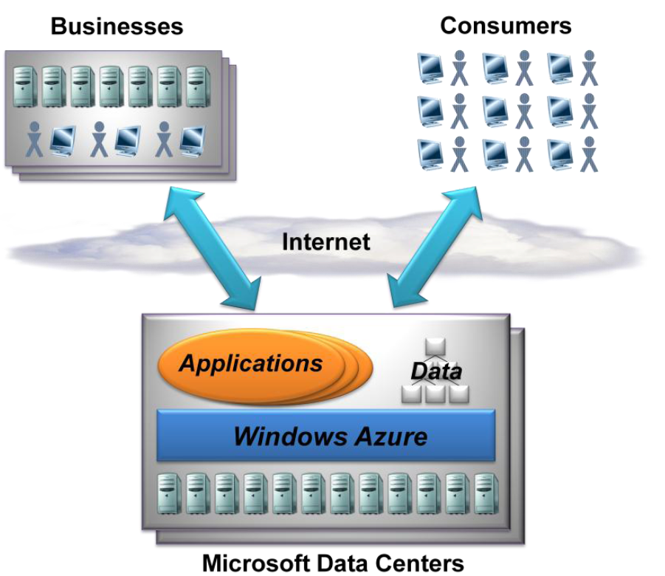
Windows Azure
Customers use it to run applications and store data on Internet-accessible machines owned by Microsoft
Those applications might provide services to businesses, to consumers, or both

Slide 46
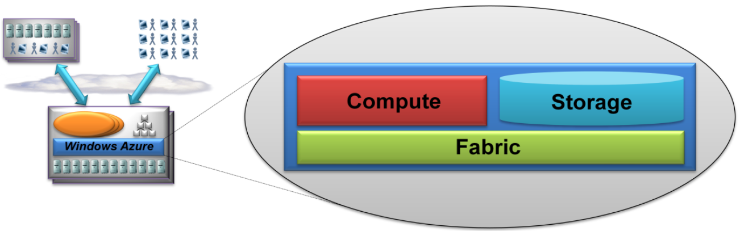
What is Windows Azure
Windows Azure is a foundation for running Windows applications and storing data in the cloud
  Provides Windows-based compute and storage services for cloud applications

Slide 47
Components
Compute
  Running applications
  Support applications that have a very large number of simultaneous users and that can scale out
Storage
  Storing and accessing data
  Applications require storage as simple blobs, a more structured way to store information, or a way to exchange data between different parts of an application
Fabric
  Managing resources
  Providing a common way to manage and monitor applications that use this cloud platform

Slide 48
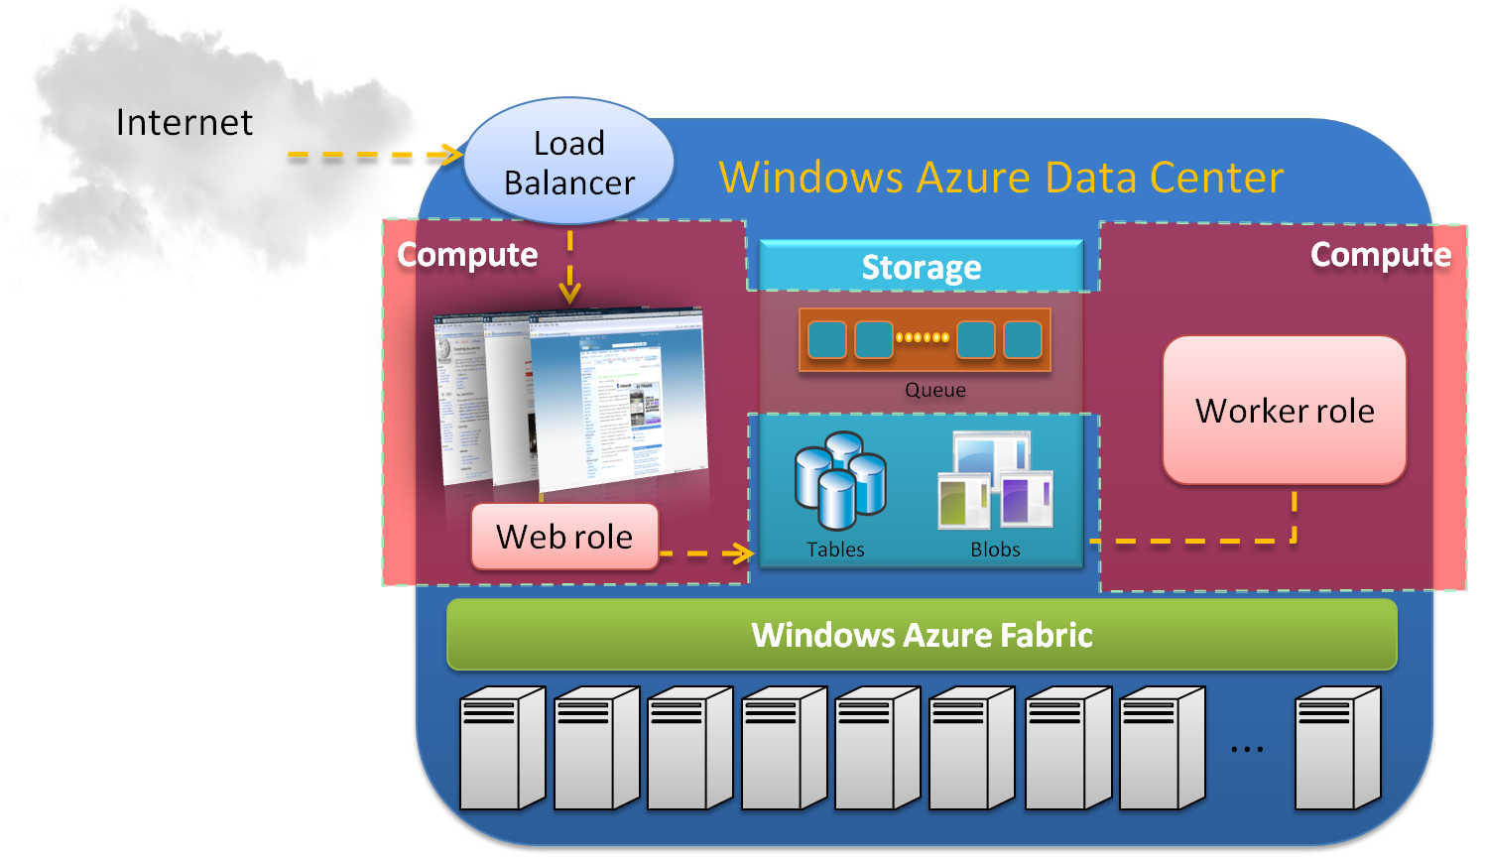
Overview

Slide 49
Windows Azure
Compute
Compute
Storage
Fabric

Slide 50
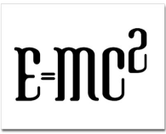


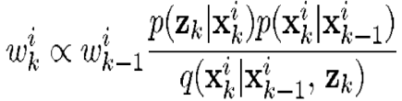
Windows Azure - Compute
In cloud computation, Windows Azure provides
  Variety of services, like web service or background computation
  A running environment of IIS 7 and .NET
Four types of compute unit
  A basic type provide single-core 1.66 GHz CPU, 1.75 GB of memory, and 225 GB of instance storage
  Incremental by power of 2

Slide 51
Compute
A Windows Azure application can have multiple instances, each executing in its own virtual machine (VM)
Each VM is provided by a hypervisor (Hyper-V)
A developer can create
  A hosting account for running applications
  A storage account for storing data
  or both
A developer can access
  The instance through an interface
  The Windows Azure portal through the Web browser

Slide 52
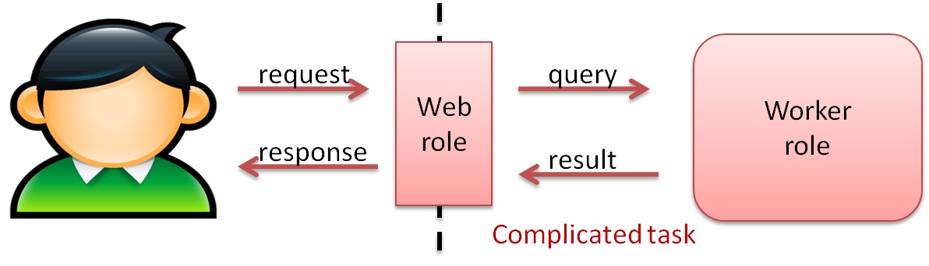
Instance Types
Windows Azure provides two types of computation roles
  Web role
    A running environment that user can access
    Web application service
  Worker role
    An environment runs particular processing
    Ability to handle distributed or complicated tasks

Slide 53
Instance Types
Any service must include at least one role of either type, but may consist of any number of web roles or work roles
Worker role can communicate with Web role using the Windows Azure storage queues
Each VM contains an agent to allow the application to interact with the Windows Azure fabric

Slide 54
Windows Azure
Storage
Compute
Storage
Fabric

Slide 55

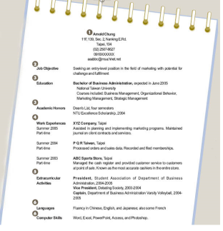


Windows Azure - Storage
In enterprise, it may need 10GB to 10PB storage space when company is growing
Enterprise does not know how many disks are needed at initial
  It could be underestimate or overestimate

Slide 56
Storage
If underestimate
  Violate the contract and does not expand storage in time
If overestimate
  Waste of resource and additional management costs
Windows Azure can take care about the storage management
  Users do not need to worry about maintaining storage space, back-up and hardware fail
  Enterprises do not need to purchase the data center nor take the responsibility of maintenance only for a peak loads

Slide 57
Storage Types
Windows Azure provides three type of storage and each one provides a special purpose
  Blob
    Provides blocks of storage that can store text or binary file
  Table
    Provides structured-based storage
  Queue
    Provides slices storages that support communication between applications
Each type of storage service has its own limitation
  Size of a file
  Number of operations at once

Slide 58
Blob
An account has his Blob storage, and can have multiple containers
Each container has multiple Blobs, each can store blocks or pages
Account
Container
Blob
Block
Block1
music
song.
mp3
Block2
John
Image1.
jpg
photo
Image2.
jpg

Slide 59
Blob Types
Block Blob
  Segment read/write
  Identify by Block ID
  Maximum size
    4MB for each block, and up to 50000 block
Page Blob
  Provided a Windows Azure Driver (aka X-Driver)
  Random read/write
  Identify by a range
  Up to 1TB

Slide 60
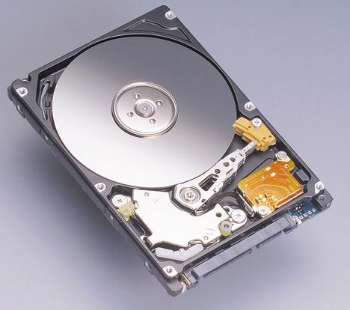
X-Driver
The underlying storage
A mechanism for viewing persistent storage as if it were a local drive
Implemented as a Windows Azure Page Blob containing an NTFS-formatted Virtual Hard Disk (VHD)

Slide 61
Table
A simple structural data storage that can store some structural data
  Similar to the EXIF information for describing a photo
Table can be used as a lightweight database
Entry is called as a line of data
Every entry has a particular identifier which contains Account Key and Table Key

Slide 62
Table
Account Name and Table Name are used to specify the account and table
Partition Key is used to specify the same data on different partitions
Row Key is an identifier of row data
Partition Key
Class
Row Key
Number
Property 1
Score 1
Property 2
Score 2
Table A
entry
Class A | No 1 | A | A+
Class A | No 2 | B- | B-
Class B | No 1 | B+ | A-
Class B | No 2 | B+ | B+
Class B | No 3 | A | A-
Partition 1
Partition 2

Slide 63
Queue
Queue usually is used between application’s communication
A queue consists of some slices
Each slice contains 8 KB data
There is a particular process to handle the queue such that each slice is processed once

Slide 64
Queue
Message queuing
Backend Processing Server
A Large-size message
Request Queue
Backend Processing Server
Multiple messages
Backend Processing Server
Web Server FE
Data location
Web Server Front-End
Blob Store
Table Store

Slide 65
Windows Azure
Fabric
Compute
Storage
Fabric

Slide 66
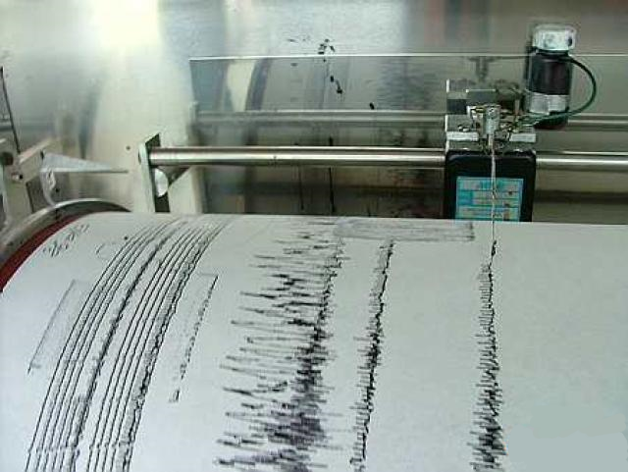
Windows Azure - Fabric
Windows Azure provides an automatic and autonomous way to manage resources
  Automatically report and recode the status of machines
  Provide a control center to perform failure recovery when one or many machines crash

Slide 67
Fabric Types
Windows Azure supports two fabrics to control and manage the machines and jobs
Fabric Agent
  Each virtual machine has one fabric agent
  Report the status to fabric controller
  Provide user’s authentication and defense of attack
Fabric Controller
  Monitor and control the virtual machine by fabric agent
  Manage the virtual machines, running environment and software configuration
  Control the work flow

Slide 68
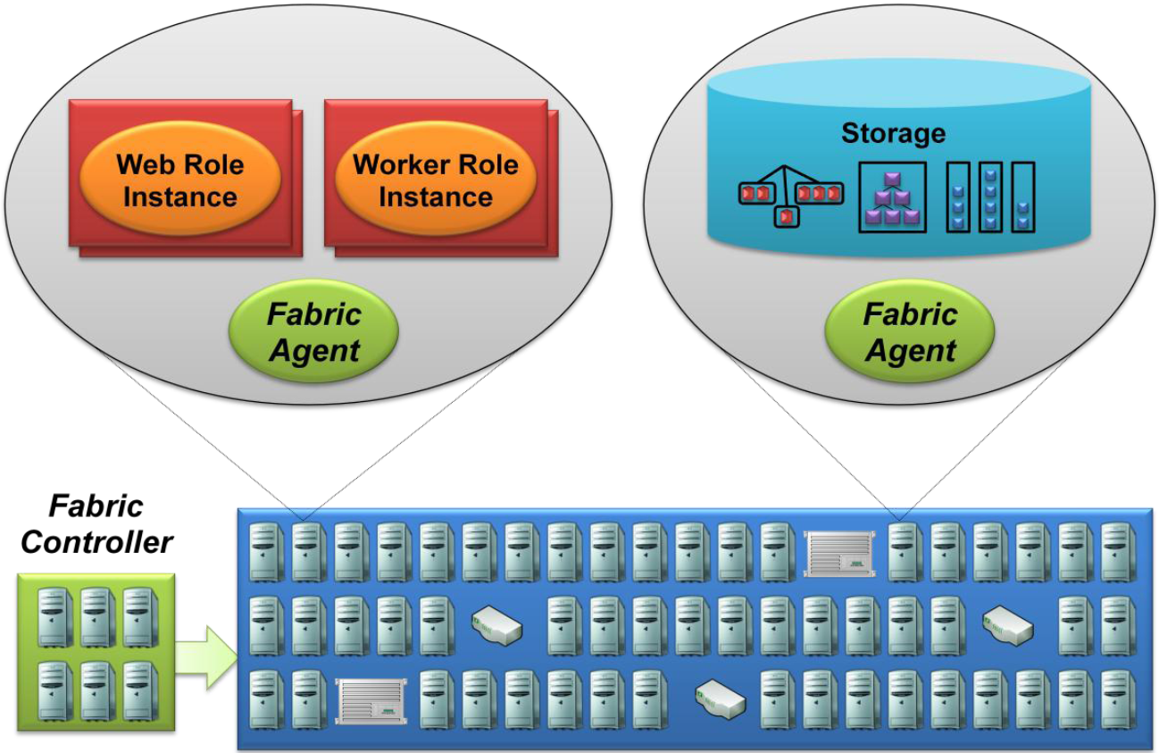
Example of Fabric
The fabric controller interacts with Windows Azure applications via the fabric agent

Slide 69
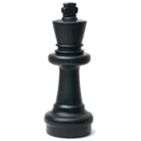
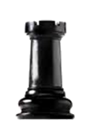




Fabric
Fabric Agent records the status of machine and reports to Fabric Controller
Who is available?
Who is alive?
job
job
job
Me
Me
Me
Me
Machine
Fabric Agent
Fabric Controller

Slide 70
Windows Azure Platform
Windows Azure
SQL Azure
AppFabric

Slide 71
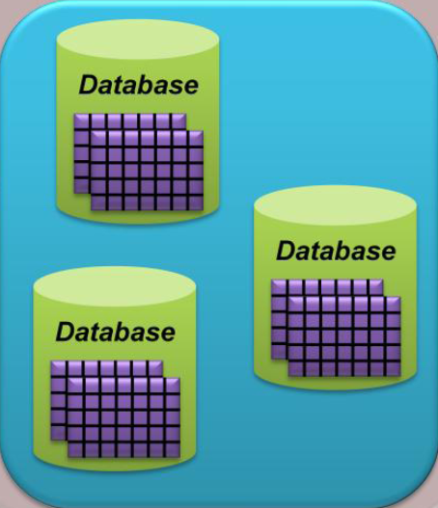
SQL Azure
In many situations, enterprises or developers might need to find the relations between data
  Enterprises need a database to store their critical and mass data
Windows Azure Platform provides the SQL Azure to approach data services

Slide 72
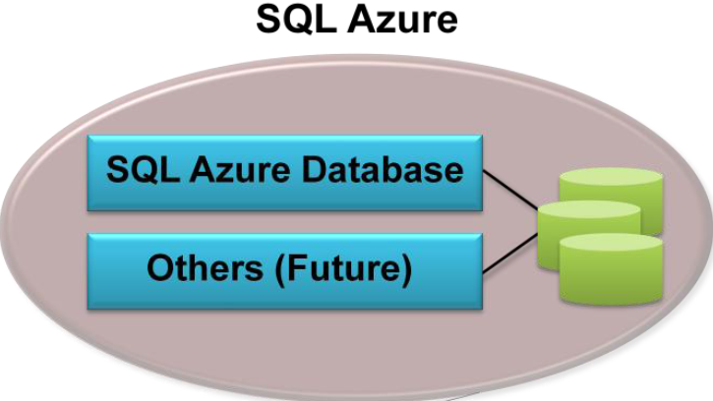
SQL Azure
SQL Azure provides a cloud-based database management system (DBMS) and data-oriented services in the cloud

Slide 73
SQL Azure
SQL Azure Database
  A relational database
  Supports Transact-SQL (T-SQL) language such that customers can use exist data model to develop services
  Integrates with SQL Server, include Visual Studio, development tools
  Reliable and scalable database on demand
Limitation
  A query can run for only a limited time
  The maximum size of a single database is 10 GB

Slide 74
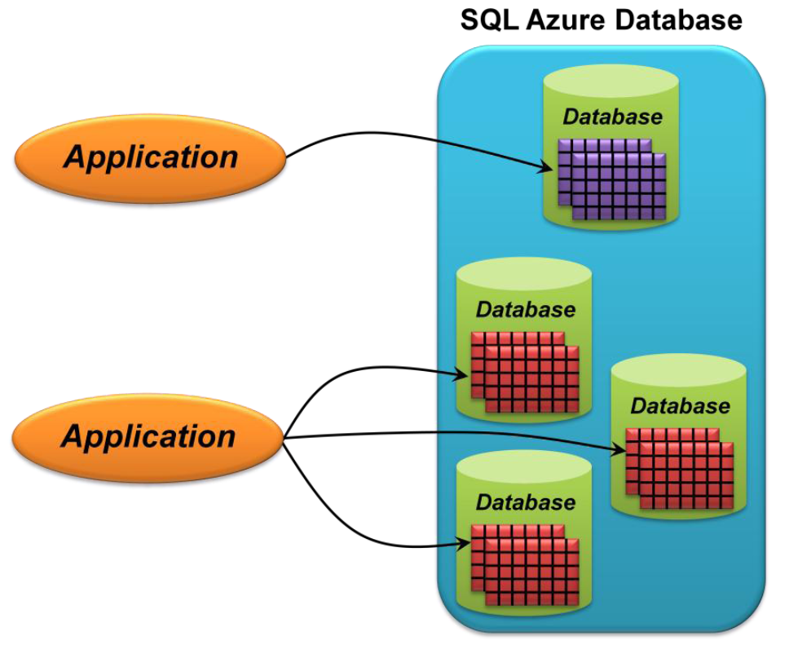
SQL Azure Database
An application can use a single database or multiple databases
  An application whose data is within the limit can use just one database
  An application with more data will need to create multiple databases

Slide 75
Architecture
Data
Application
Database
Server
Browser or
Service Client
Windows Azure Cloud Applications
SQL Service Load Balancer
Service Layer (SQL Azure Gateway)
SQL Azure
Backend
SQL Azure
Backend
SQL Azure
Backend
…………
SQL Azure
Backend
Windows Azure Computes
TDS
HTTP

Slide 76
Architecture
Application can access the proper database which storing its data
  Coordinate by the SQL Azure Fabric service
  Link to a database via the connection routing
  Do not care about the exactly location of database
Each connection between application and SQL Azure could link to different database servers
  Provide a high availability

Slide 77
SQL Azure Gateway
SQL
Native Client
SQL Azure
Management Portal
WCF Data
Service
SQL Azure Gateway is the critical component
  Access data
  Handle commands
With the Gateway, user can ignore the detail of backend server
  Network topology
  System deployment
  Maintain method
Connection
Manager
Admin
Endpoint
Provisioning
Endpoint
Protocol
Parser
Business Logic Services
Connection Manager

Slide 78
SQL Azure Gateway
Connecting to the gateway can access all functionalities on SQL Azure
Gateway will check the TDS (a communication protocol used by SQL Server)
  Analyze malicious commands
  Authenticate the account
  Billing
Gateway redirects TDS to the backend server, and packs the result as a security TDS to client

Slide 79
Backend Server
SQL Azure is build on Windows Azure’s computes unit
  High available
  Distributed storage system
Other Server’s
SQL Azure Fabric
SQL Azure Fabric
SQL Server
Instance
Databases
Other Server’s
Management Service
Management Service

Slide 80
Backend Server
SQL Azure Fabric manages databases that stores data in many SQL Azure nodes distributively
SQL Azure Fabric controls the policy and frequency of data replication
  Merge replication
  Transactional replication
Access any one of SQL Azure service can link to the proper database and get the correct data

Slide 81
Windows Azure Platform
Windows Azure
SQL Azure
AppFabric

Slide 82
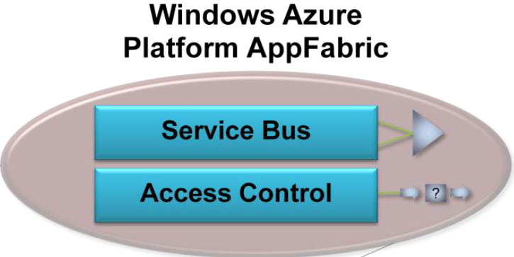
AppFabric
AppFabric provides cloud-based infrastructure in connecting distributed services and applications

Slide 83
AppFabric
What AppFabric can do
  Make connections between applications possible
  Provide a service application for enterprise-level architecture
  Based on open communication and standard of service, venders provide the concept of service reusability
Components
  Service Bus
    Makes connection simpler by letting an application expose endpoints that can be accessed by other applications
  Access Control
    Provides the ability for applications with authentication and authorization

Slide 84
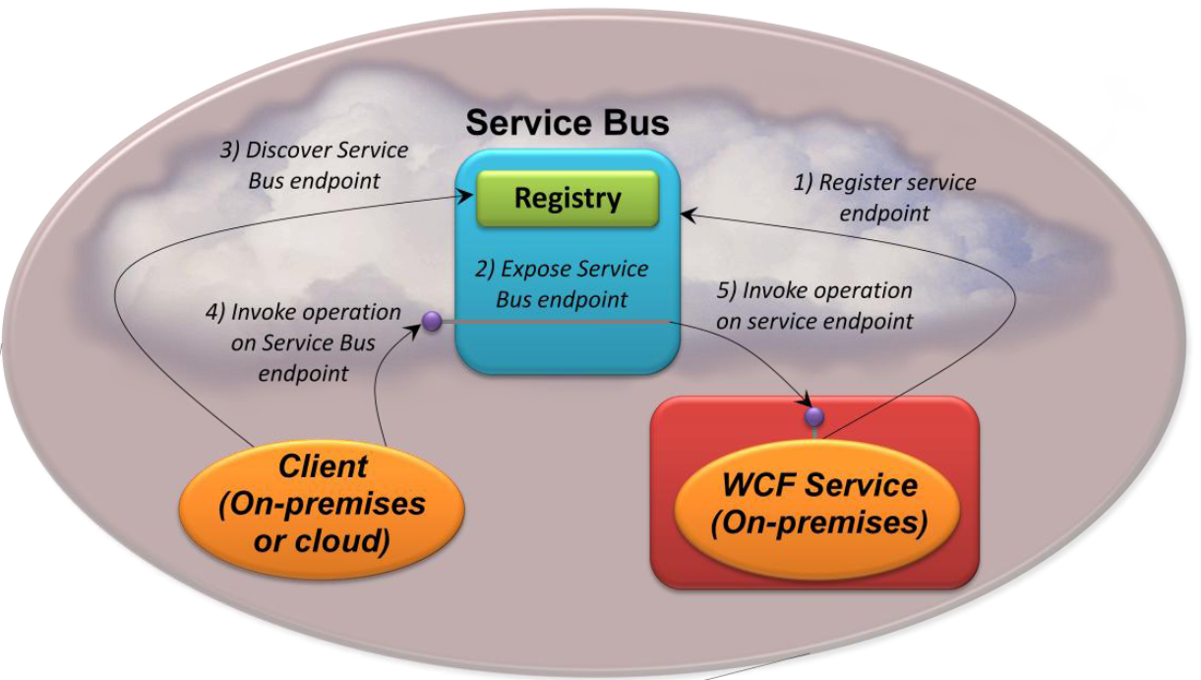
Service Bus
Service provider can register endpoints with Service Bus
Service consumer can discover and use those endpoints to access the service
Service
Consumer
Service
Provider

Slide 85
Service Bus
AppFabric Service Bus supports two types of communication mechanisms according to client application
  Message reply
  Directly connect
Client application can set the Hybrid connection mode
  Try to use directly connect
  If Service Bus does not detect the direct connection,
  use the message reply

Slide 86
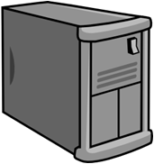


Message Reply
Service application
(inside the cloud)
Service Bus
Service Bus
reply message
Service Registry
Client requests
the service by URL
Service application
(outside the cloud)
Client

Slide 87
Directly Connect
Service application
(inside the cloud)
Service Bus
Service Bus probes
a directly link if possible
Service application
(outside the cloud)
Client

Slide 88
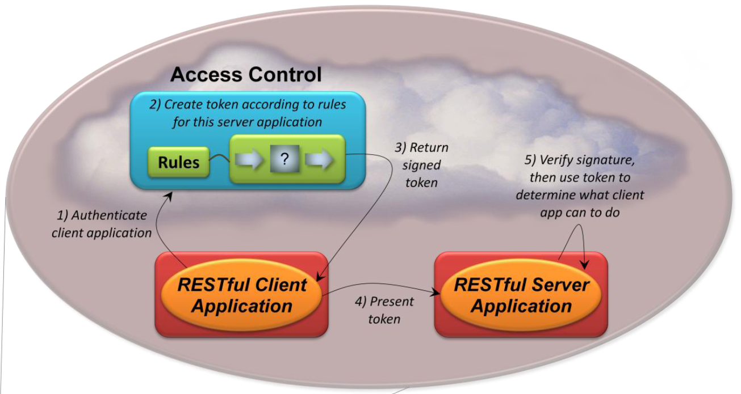
Access Control
Access Control service helps applications authenticate and receive identity information about their client applications
Client
Application
Server
Application

Slide 89
Access Control
Access control is a Single Sign-On (SSO) service for service bus
  User accesses the service bus must be authenticated by the access control
User only needs a token when access multi-services
  The token can be recognized for multi-services in a period of time

Slide 90
Windows Azure Platform
Scenarios
  Creating a web application with background processing
  Using cloud storage from an on-premises or hosted application

Slide 91
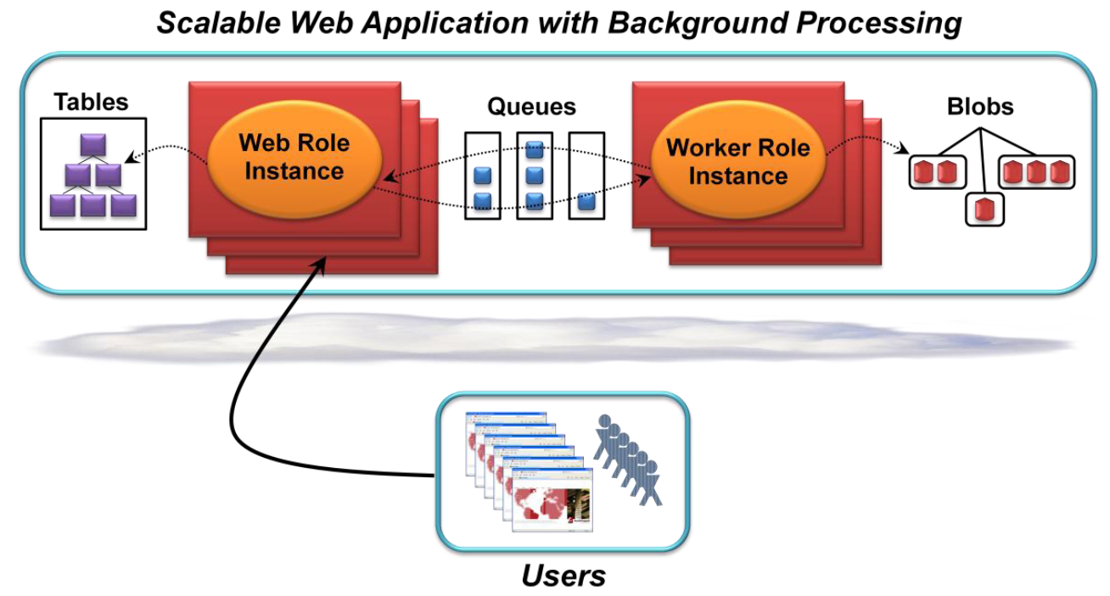
Scenario 1
Web application with background processing
  Scalable
  Support a large number of simultaneous users

Slide 92
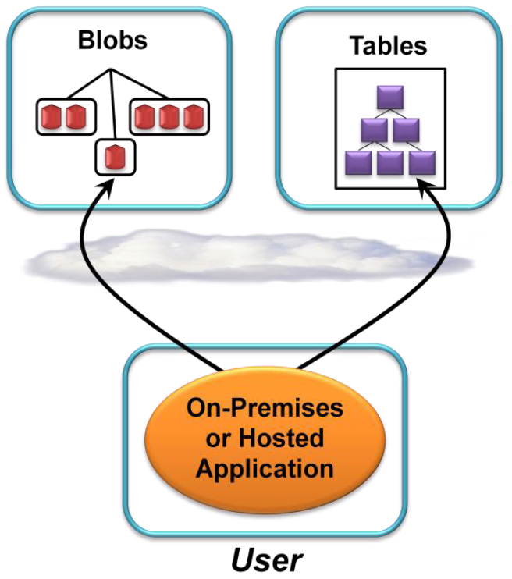
Scenario 2
An on-premises or hosted application can use Blobs and Tables to store its data in the cloud
  Access is likely to be slower, but
    Cheaper
    Scalable
    Reliable

Slide 93
Summary
Microsoft Windows Azure platform could
  Support applications, data, and infrastructure in the cloud
  Provide a subset of SQL server’s functionality to support the relational database and SQL-like queries
  Create an application whose code and data can exist either on-premises or in the cloud
  Charge based on your usage
  Guarantee
  …
Guarantee | Rate
External connection | 99.95%
Web / Worker role process | 99.9%
Success of insert, update, delete data | 99.9%
Access of SQL azure | 99.9% (per month)

Slide 94
Properties & Characteristics
Scalability
  Provide scale-out compute/storage capability of handling very large amounts of application/data
Availability
  Provide the ability of failure tolerance such that application or service would not stop on failure
Manageability
  Let applications run continuously while minimizing the administrative effort required
    In particular, customers do not worry about Windows patches
Performance
  Provide load balancing to spread request across Web role instances and support parallel processing with Worker role instances
Accessibility
  Control and monitor running instances through the web portal or the programming APIs

Slide 95
References
Web resources:
  Microsoft Windows Azure. http://www.microsoft.com/windowsazure/
  Chu’s blog. http://www.dotblogs.com.tw/regionbbs/
  From Wikipedia, the free encyclopedia.
Book:
  小朱, Windows Azure教戰手札：您必須學會的微軟雲端開發技術, 碁峰 2010
All resources of the materials and pictures were partially retrieved from the Internet

